Slide 1

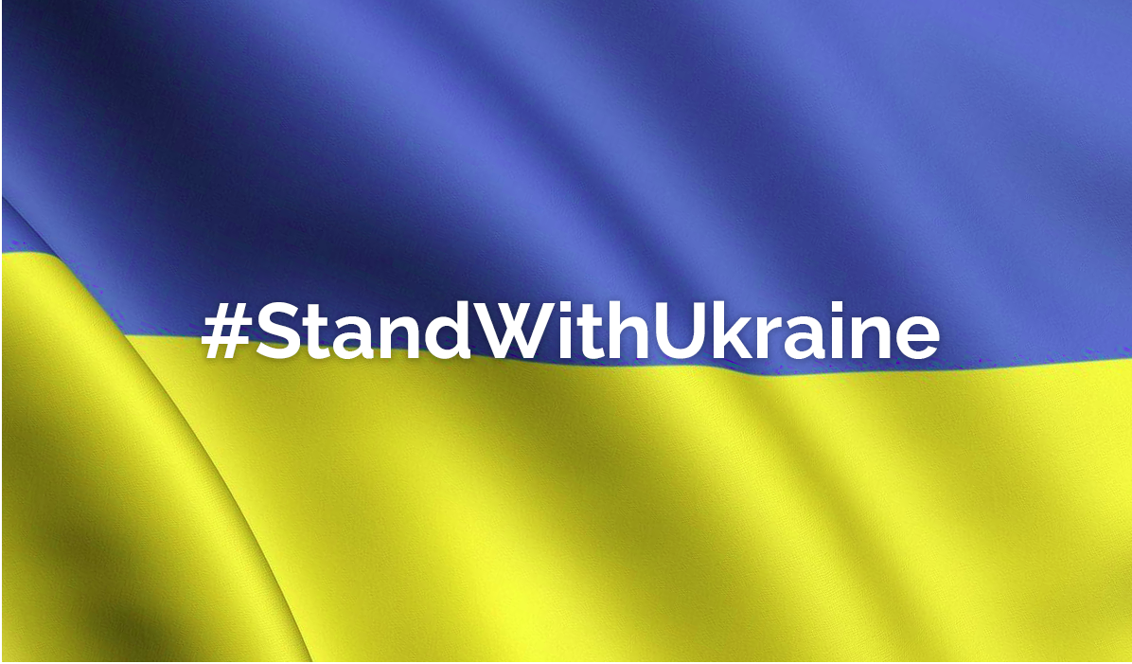
NFT AUCTION 2022 Effort to Support Ukraine Live at 6:30PM June 1st
Hosted By:
Fabrice Salomon
Diego Torres
Sean Endicott
Josina Baiao

Slide 2
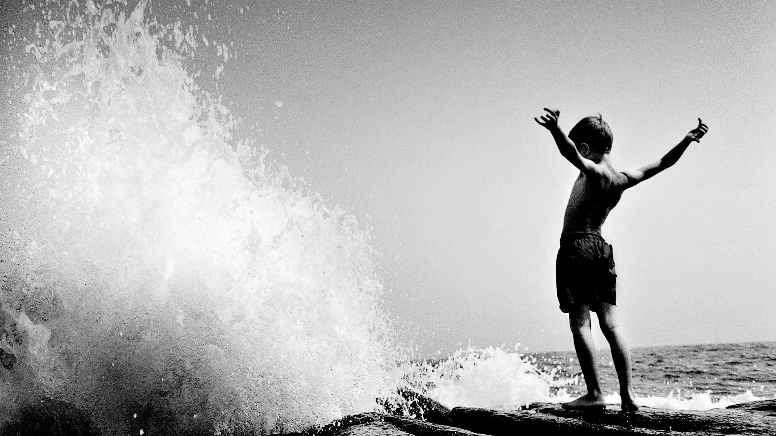
Our Goal
The conception of this project was the convergence of modern tech and philanthropy by the minds and hearts of 4 Fintech students. We wanted to build something to help Ukraine in the fight to defend their country and help the victims of the on-going atrocities. As a struggling student, I have neither fiat or crypto currencies to donate to the cause. We then came to realize the need for a donatable option other than currencies. This project's aim is to not only create another channel to raise charitable funds but, to also accept digital art as a donation. The art that is donated will be converted into an NFT and auctioned for ETH. This project is a digital marketplace which will auction art as well as accept donations in the form of ETH or digital art. All proceeds form this marketplace will be forwarded directly to approved charities for this cause.

Slide 3
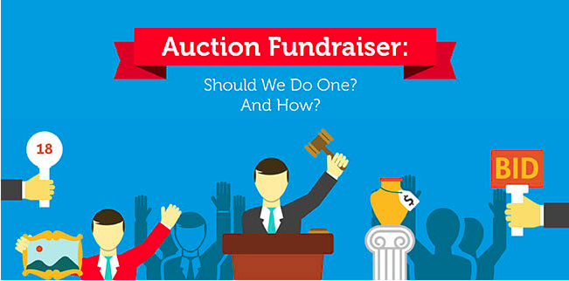


z
THE DAPP
The Ukraine fund marketplace uses the Ethereum blockchain for this marketplace. The ERC721 smart contracts are written in Solidity and the user's interface will be run through Streamlit. The digital representation of the art will be pinned to IPFS by Pinata

Slide 4
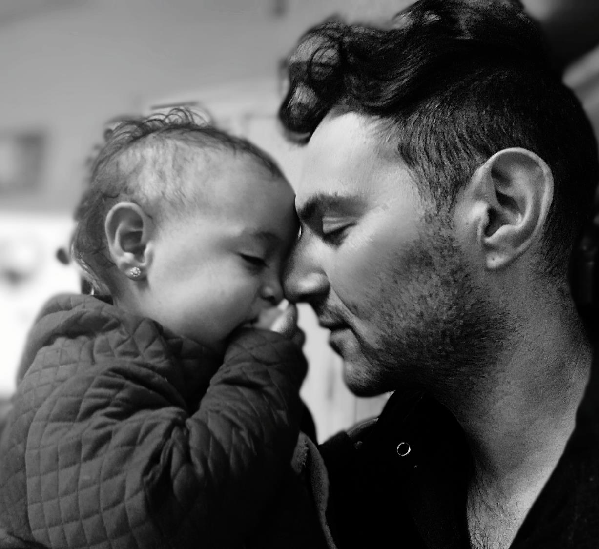
BALANCING ACT
We used Remix to write, compile, and deploy the contracts.
Metamask and Rinkeby were used for the test wallet.
Rinkeby faucet offers tokens daily.
Pinata and IPFS were used for the art
Streamlit is used to interact with the contracts
Languages used include Solidity, Python, and JSON

Slide 5

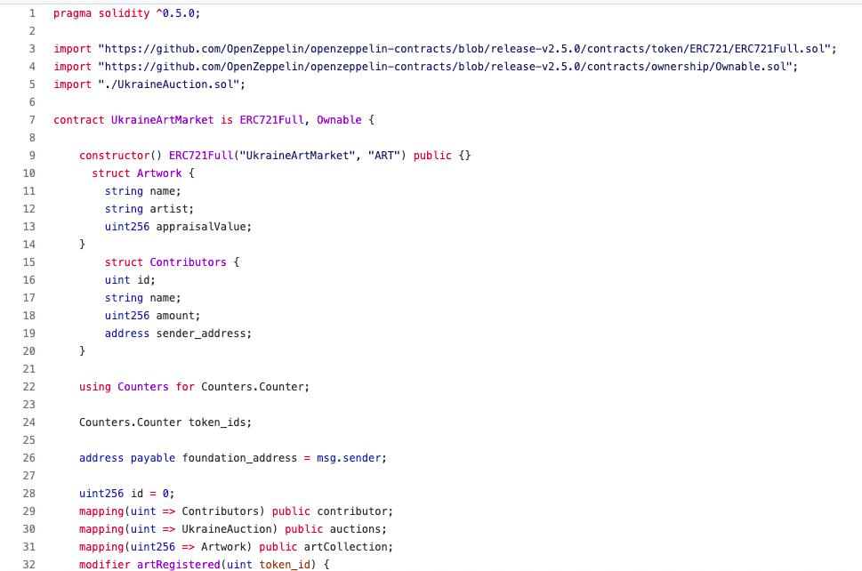
Contracts
UkraineArtMarket.sol
z

Slide 6
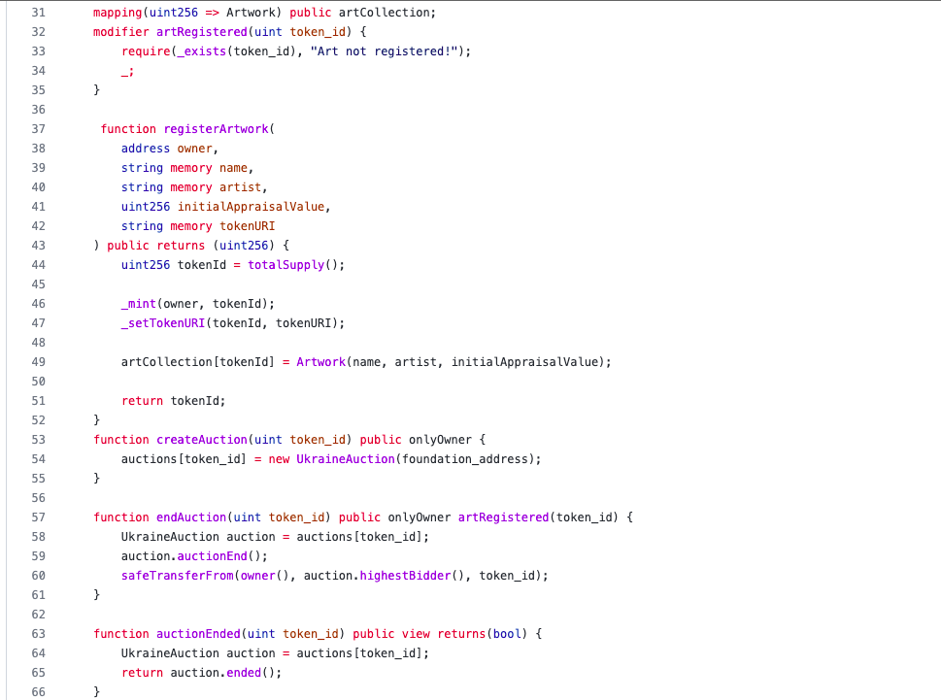
UkraineArtMarket.sol
z

Slide 7
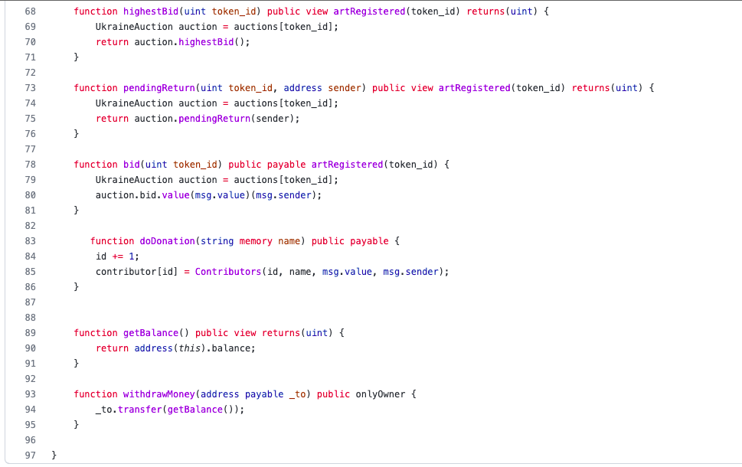
UkraineArtMarket.sol
z

Slide 8
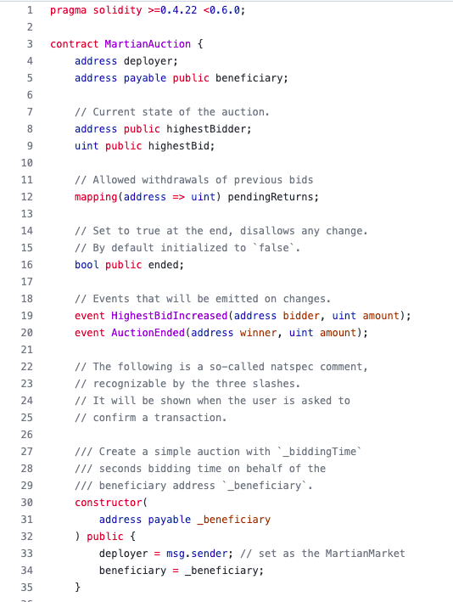
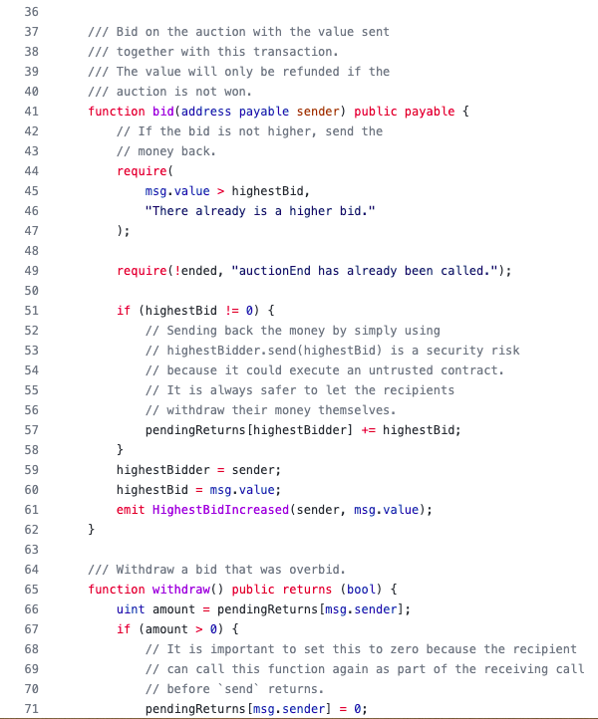
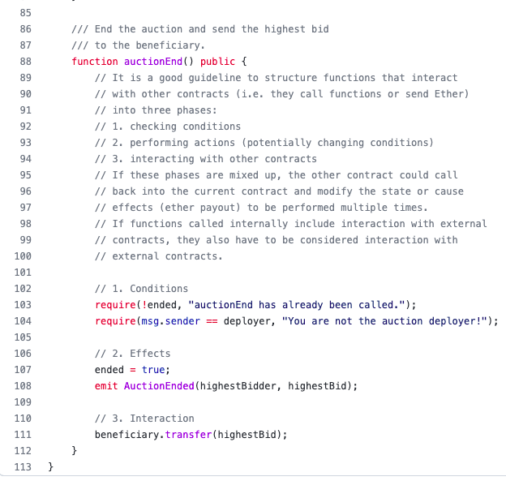
UkraineAuction.sol
z

Slide 9
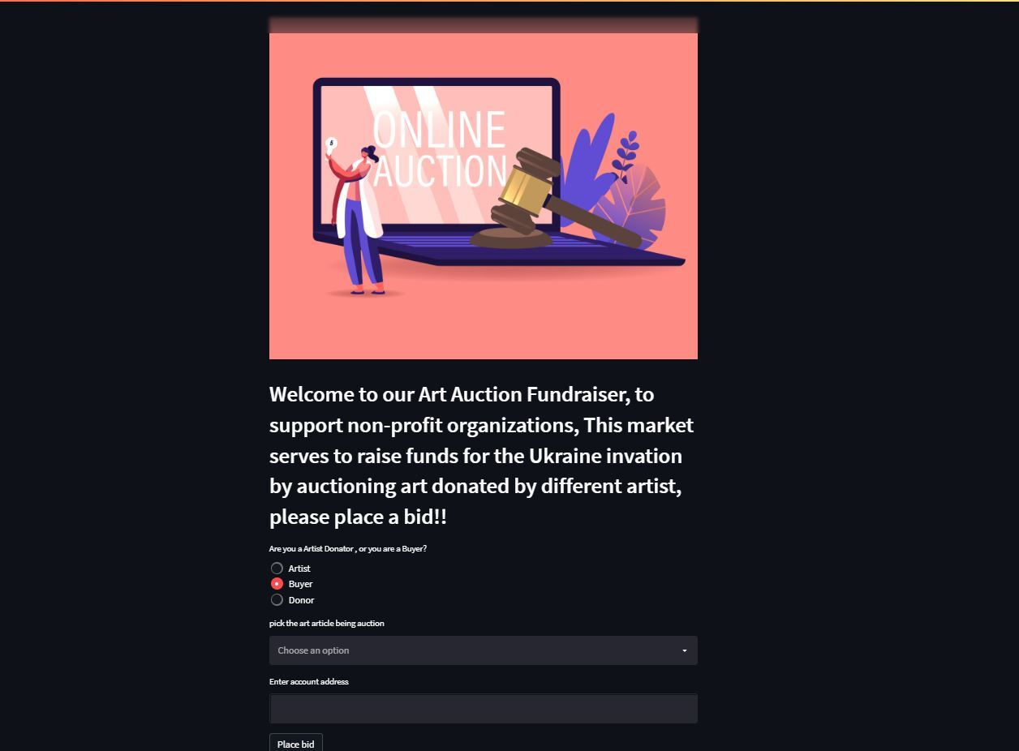
STREEM

Slide 10
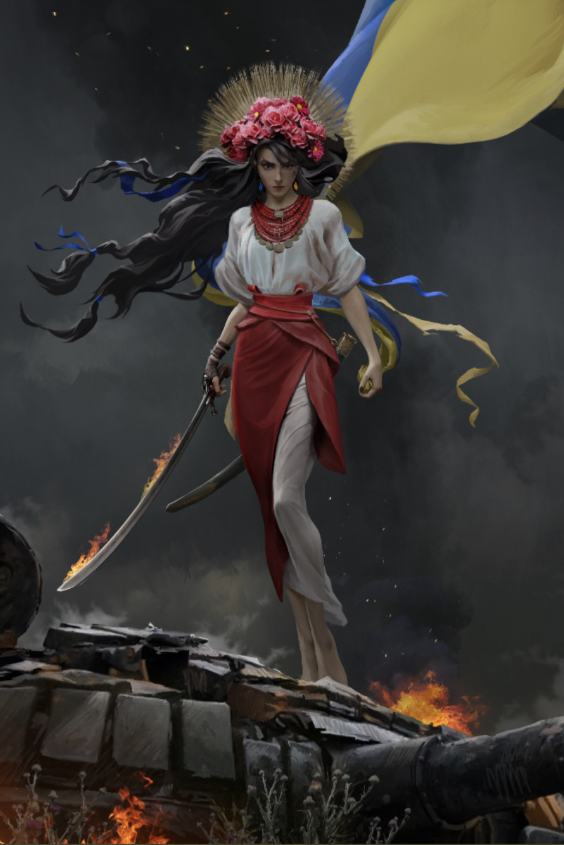
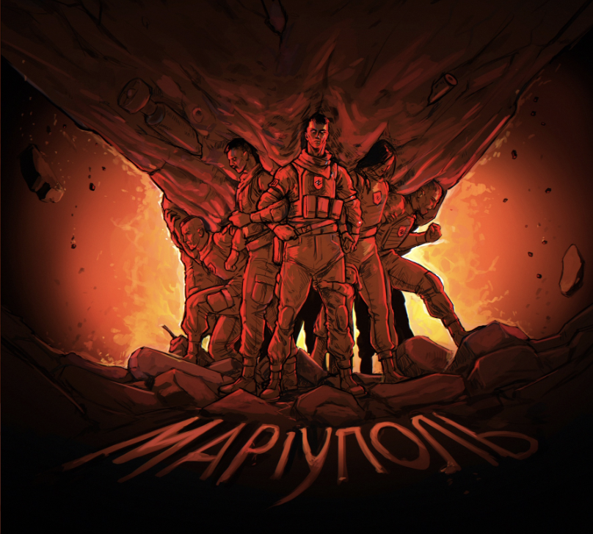
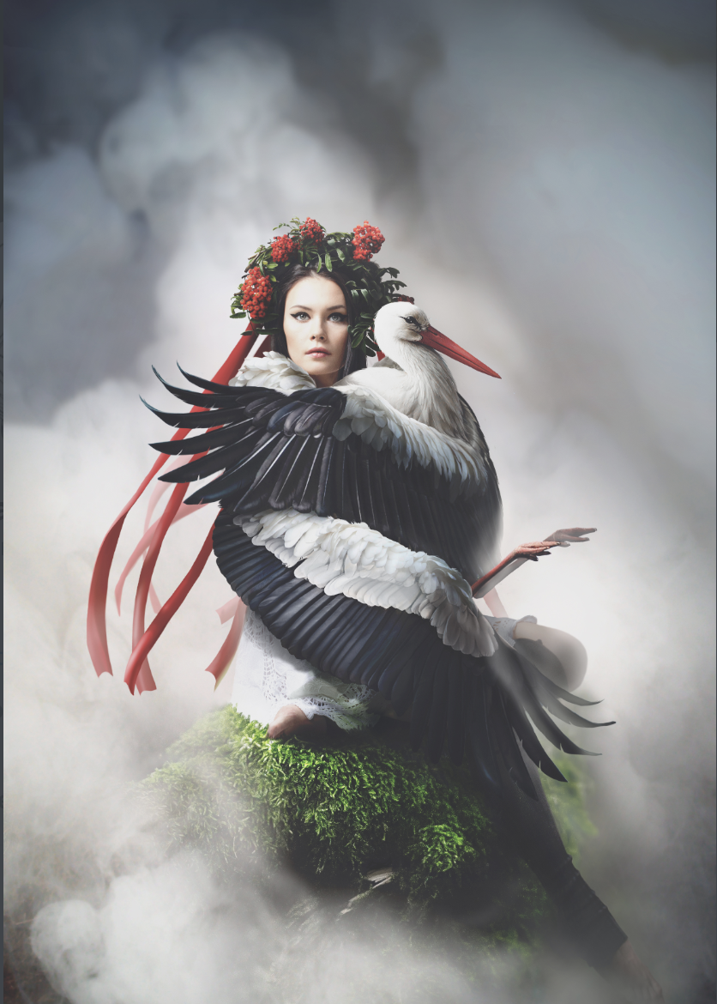
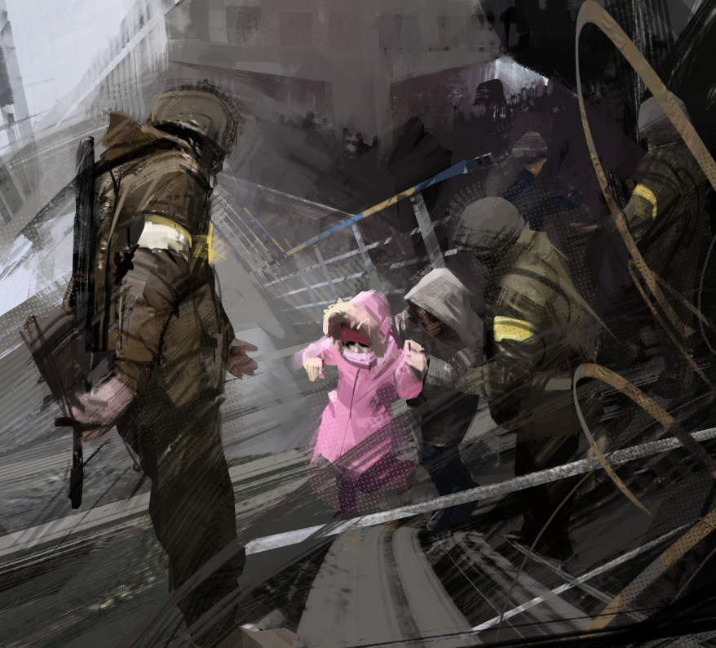
"Avatar"
“Brotherly Arms”
NFTs Live Auction
Starting Bid:
"Brotherly Arms” 3 ETH
“Avatar” 6.5 ETH
“Beauty Comes From
The Heart” 7 ETH
“Help You People” 10 ETH
“Fight” 2 ETH
“Protection” .075 ETH
”The Ancestors” 2.3 ETH
”Will Not Surrender” 8 ETH
“Beauty Comes From The Heart”
z
“Help Your People”
Notes:
Link to NFTs
https://ipfs.io/ipfs/QmXz997DowsBcEcspKUMfjHLL2zB5YEKq3cCKALVEjjeFu - "Avatar”
https://ipfs.io/ipfs/QmVgnH5CY9D4uE4TXMWXLrh5DyTKTUfB1FqSrJKCqhHJLA - "Brotherly_Arms”
https://ipfs.io/ipfs/QmRLLH6sce7JwWnhzfGStxc2VkFreTAkQPJZGnCfwYcU3w - "Beauty_Comes_from_the_Heart”
https://ipfs.io/ipfs/QmNcFP3hhf8QDDHVUX3PT6roVzD6oHty1maiAeXiApLhKC - "Help_your_people"

Slide 11
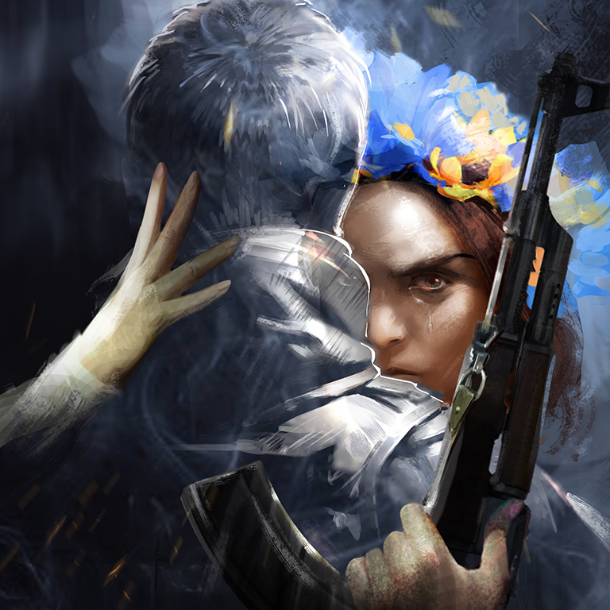
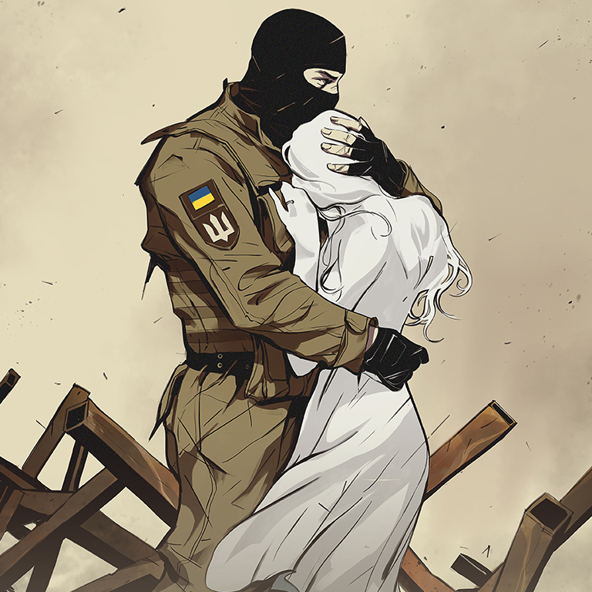
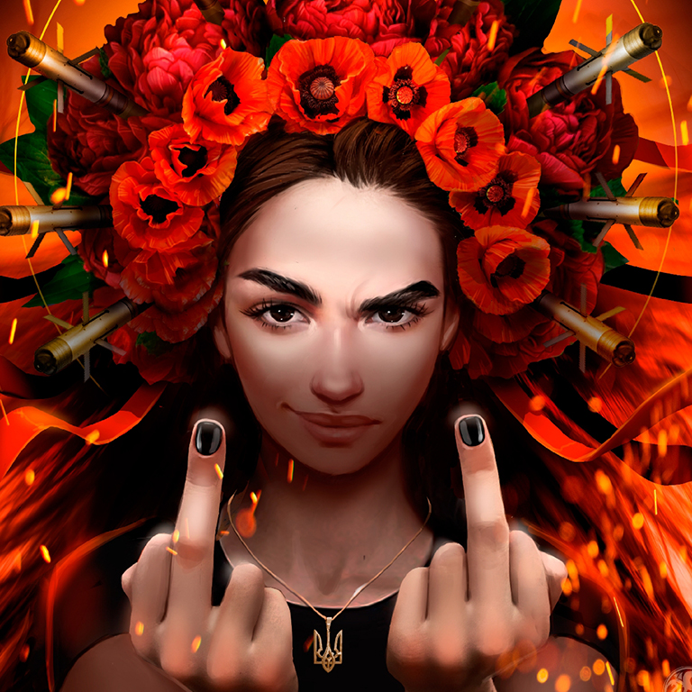
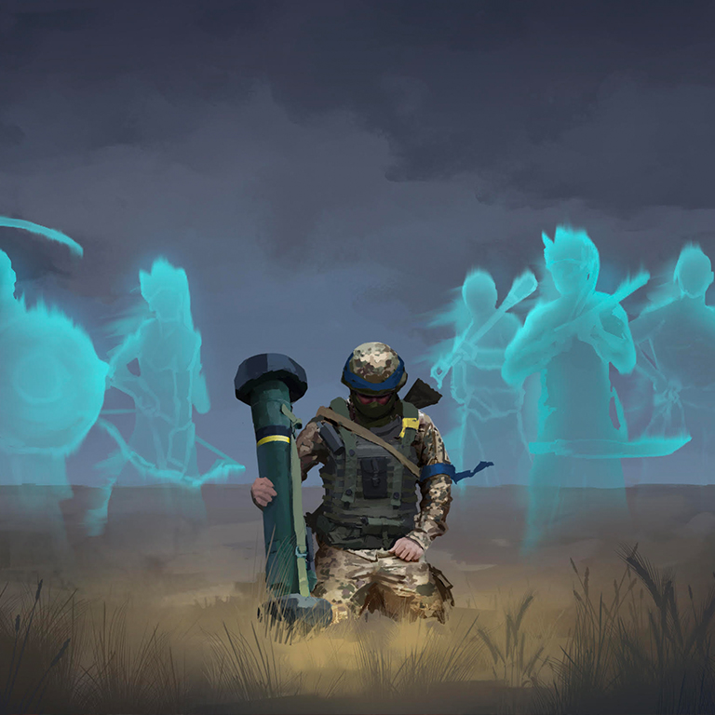
"Will Not Surrender"
" Protection"
"Fight"
"The Ancestors"

Slide 12
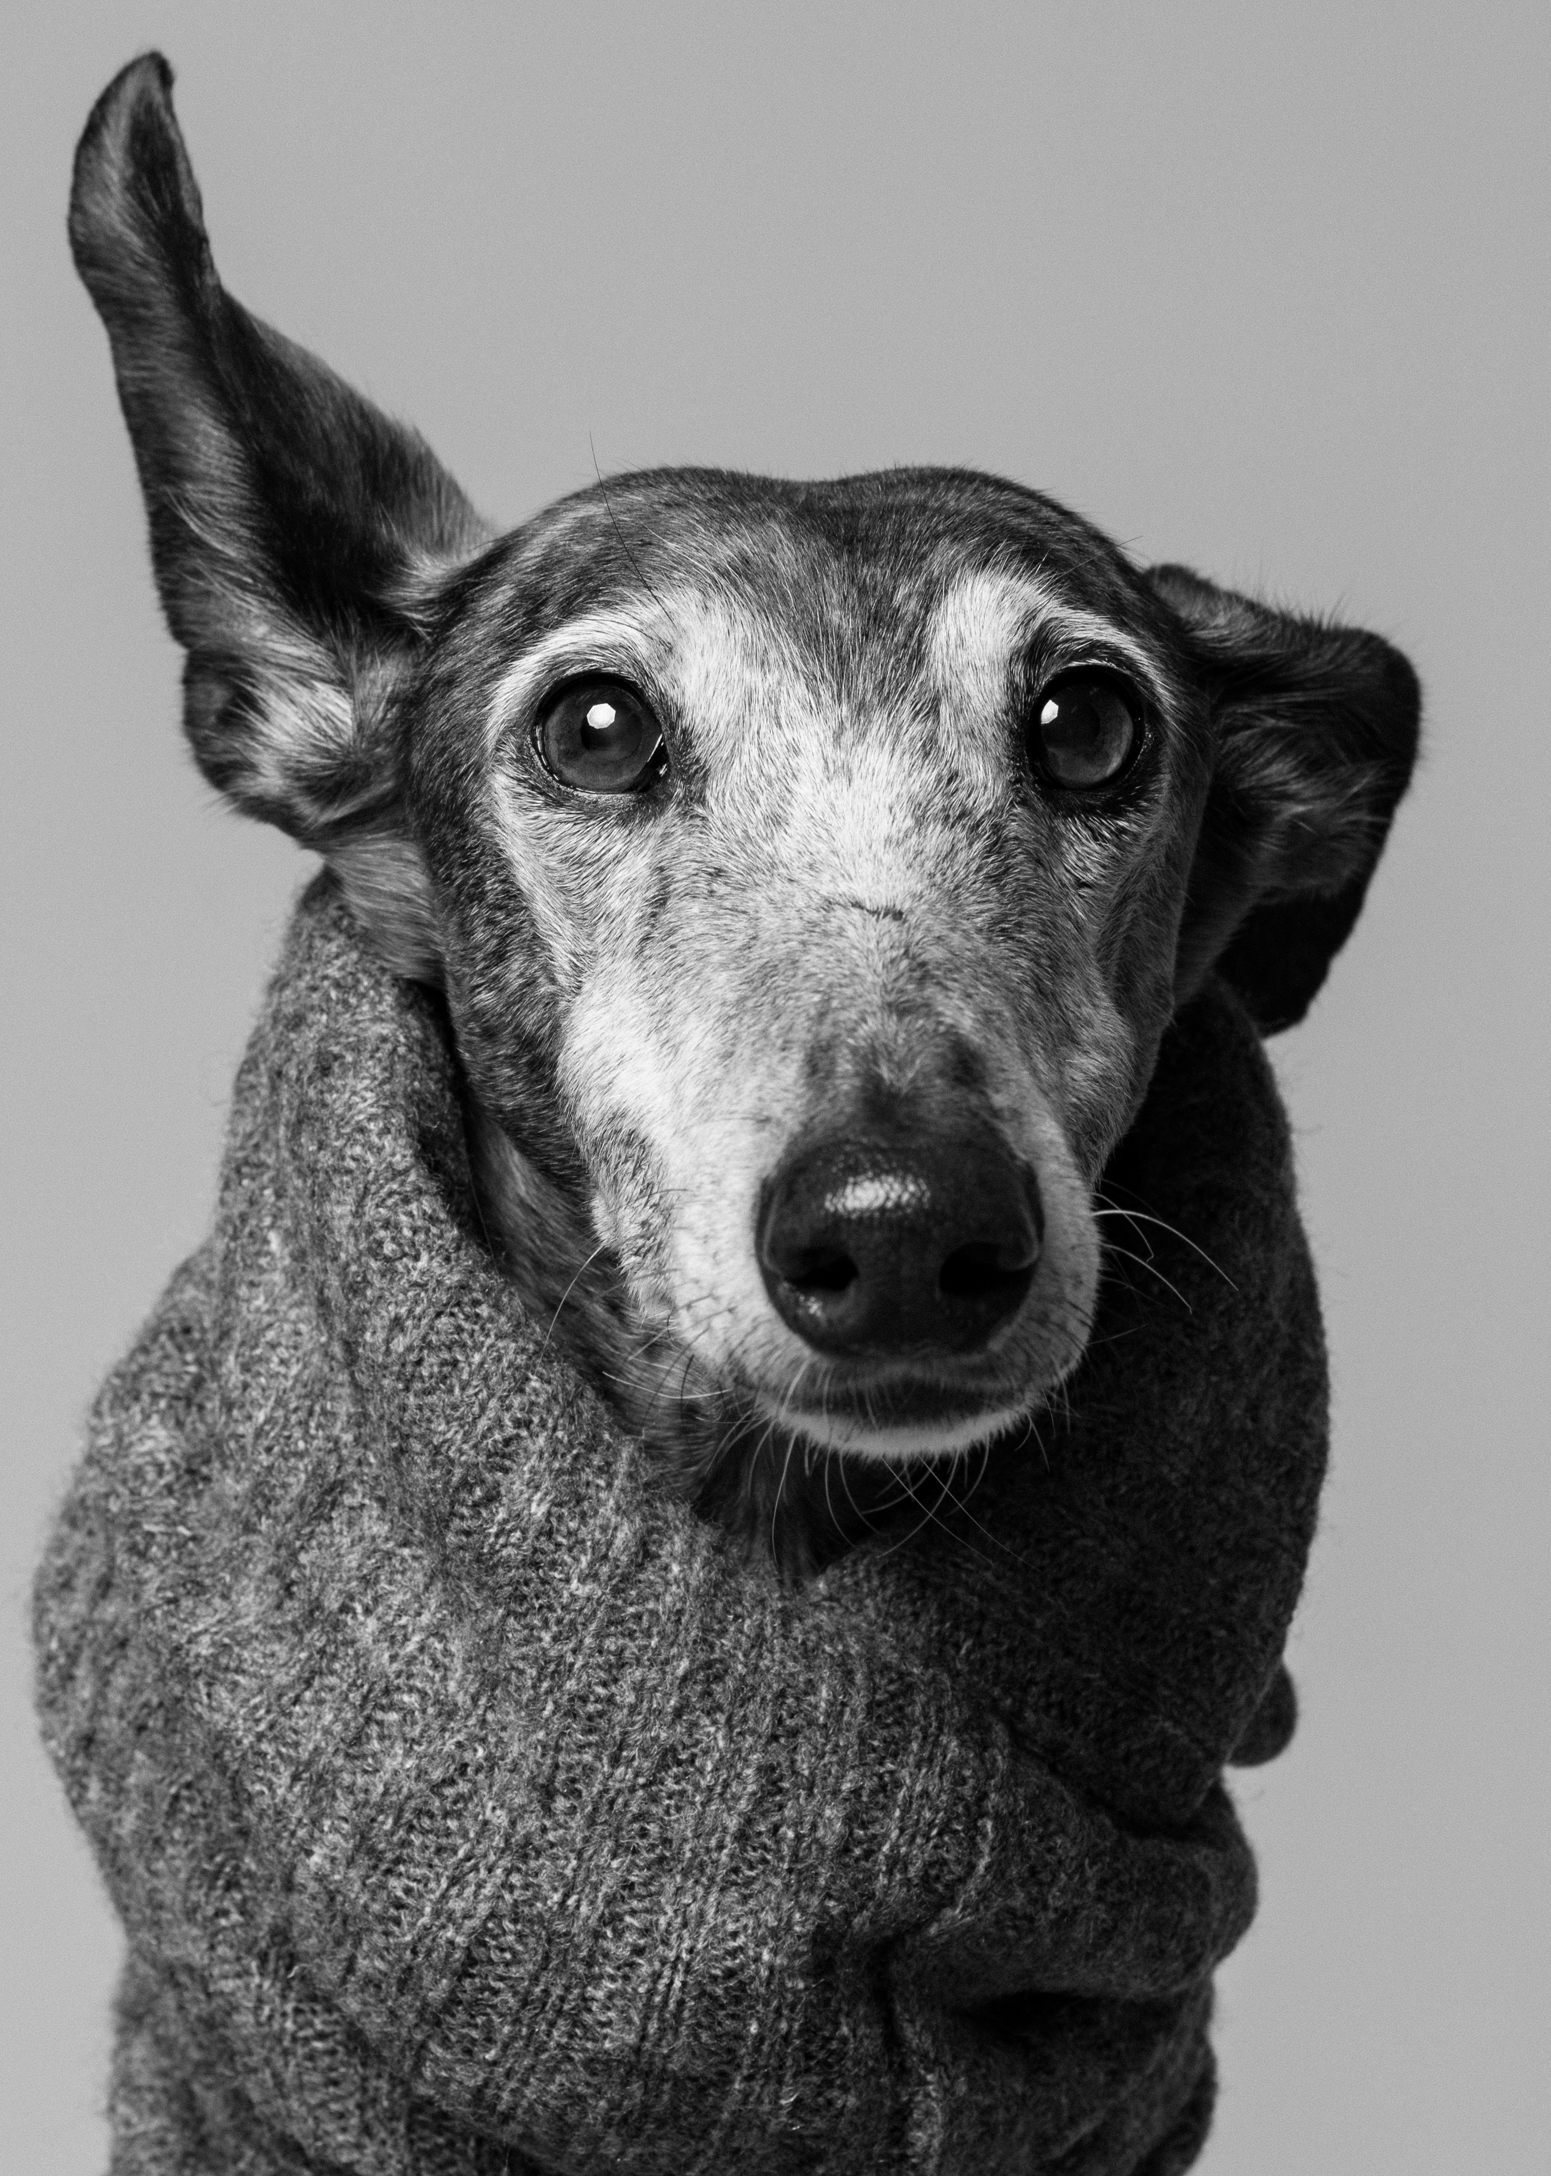
Summary
The Ukraine Fund Marketplace is intended as a steppingstone in the evolution of philanthropy and humanity. We are able to extend the arena of resources by using the emerging technologies of blockchain and smart contracts. The cost efficiencies are also greater for blockchain processed charitable, which means more funds get to those in need compared to traditional methods. Finally, any good faith gesture can become an actionable donation.
If some give a lot and a lot give some, we could all help and receive help when needed. My art is a photograph, maybe yours is a drawing, a coin, or promise to host a displaced family. It is now easier than ever to give, even when you can't afford to give money.
Notes:
Ukraine government website
IMD
Avatars For Ukraine

Slide 13
QUESTIONS ?
Notes:
Ukraine government website
IMD
Avatars For Ukraine

